Slide 1


Threat Modeling and NIST CSF v2: A Practical Approach
Understanding, Applying, and Aligning security practices through effective threat modeling and the NIST Cybersecurity Framework v2. This presentation explores how these methodologies work together to create a comprehensive security strategy for your organization.
We'll examine practical approaches to identifying threats, assessing risks, and implementing appropriate controls within the expanded NIST CSF v2 framework.
by Alessandro Magnosi

Slide 2


What is Threat Modeling?
Threat modeling is a structured process to identify, assess, and mitigate security risks in a system's design. It focuses on "what could go wrong" by systematically analyzing components, data flows, and actors within your systems.
The core objective of threat modeling is to find and fix flaws before they become exploitable vulnerabilities. This proactive approach helps organizations build security into their systems from the ground up rather than adding it as an afterthought.
Structured Process
Proactive Focus
Follows a methodical approach to security analysis
Identifies issues before they become vulnerabilities
Design-Level Analysis
Examines architecture and components holistically

Slide 3
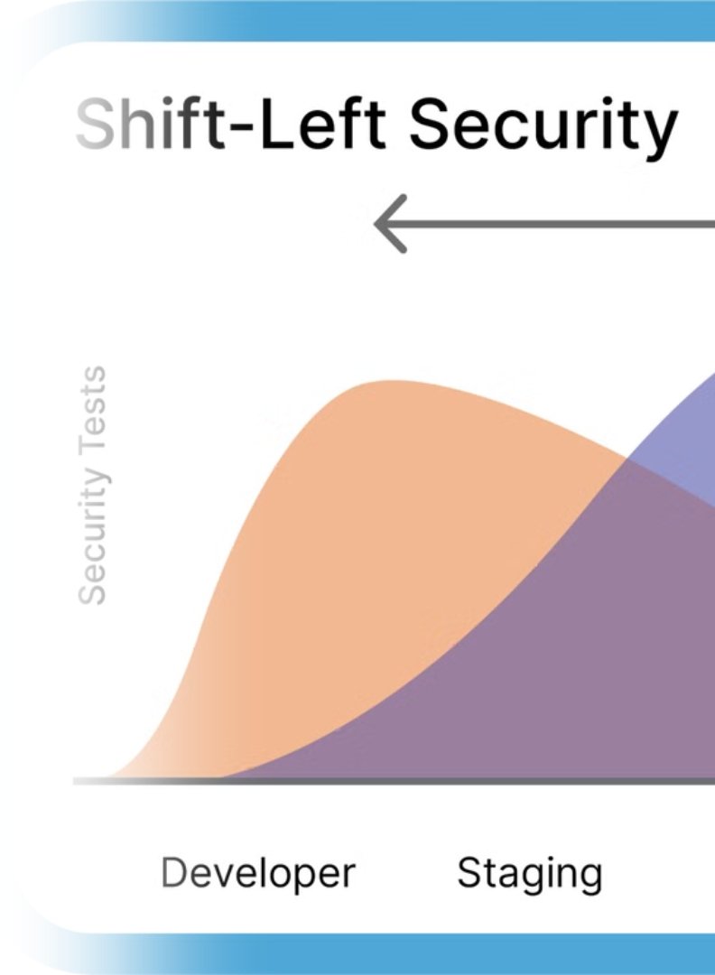
Why Threat Modeling Matters
Up to 80% of critical vulnerabilities are design-level issues that could be identified early through proper threat modeling. This staggering statistic highlights the importance of addressing security concerns during the design phase.
Threat modeling helps reduce rework and patching costs, improve architectural clarity, and enable a proactive security culture. It's a key practice for "shifting security left" in the development lifecycle, addressing potential issues before they become costly problems.
80%
3x
Critical Vulnerabilities
Cost Reduction
Found at the design level
When fixing issues early vs. post-deployment
60%
Architectural Clarity
Improvement through modeling process

Slide 4





When Should Threat Modeling Be Performed?
Effective threat modeling should begin early during requirements and design phases, but it doesn't stop there. It should be performed continually at every feature addition or system change to maintain security throughout the development lifecycle.
In Agile environments, teams should "threat model every story" to ensure security is built into each increment. Integration into the CI/CD pipeline provides ongoing assurance that security considerations remain at the forefront of development efforts.
Requirements & Design
Start early to influence architecture
Feature Development
Model each new feature or change
CI/CD Integration
Automate checks in pipeline
Continuous Updates
Revise models as systems evolve

Slide 5


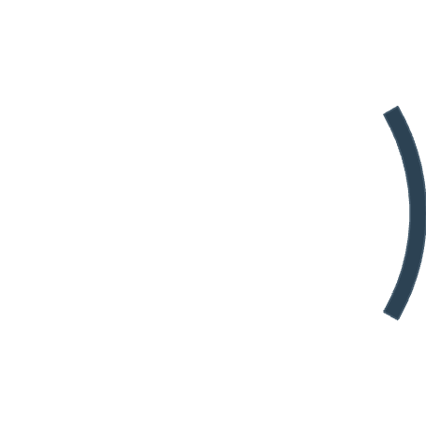


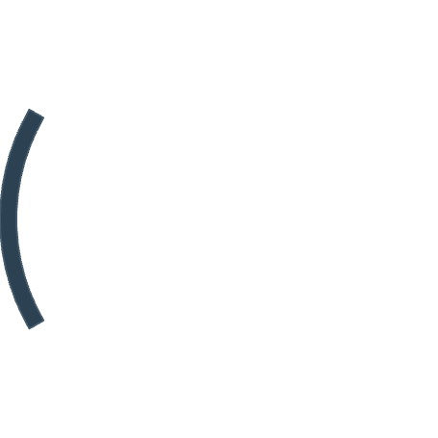






Core Concepts
Understanding the fundamental concepts of threat modeling provides a common language for security discussions. These core elements form the building blocks of any threat modeling exercise and help teams systematically analyze potential security issues.
By clearly defining assets, actors, weaknesses, vulnerabilities, threats, and risks, organizations can develop a comprehensive view of their security landscape and prioritize their defensive efforts appropriately.
Assets
Actors
Valuable data or functionality that needs protection
Users or adversaries interacting with the system
Risk
Weaknesses
Likelihood × impact of a threat event
Design or implementation flaws
Threats
Vulnerabilities
Potential malicious actions
Exploitable weaknesses

Slide 6
The Threat Modeling Process
The threat modeling process follows a structured approach that guides teams through systematic security analysis. Each step builds upon the previous one to create a comprehensive understanding of potential threats and appropriate mitigations.
This iterative process helps organizations identify and address security concerns throughout the development lifecycle, ensuring that security is built into systems rather than bolted on afterward.
Define the scope
1
Clearly identify what system or component we are modeling, establishing boundaries for the analysis.
2
Model the system
Create diagrams and identify trust boundaries to visualize how the system works and where vulnerabilities might exist.
Identify threats
3
Apply structured thinking (e.g., STRIDE) to systematically uncover potential security issues.
4
Prioritize risks
Score and rank threats based on likelihood and impact to focus mitigation efforts.
Mitigate
5
Apply controls and update the design to address identified threats and reduce overall risk.

Slide 7

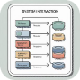
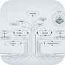
System Modeling Techniques
Effective system modeling is the foundation of successful threat modeling. Various diagram types help visualize different aspects of the system, exposing trust boundaries, data flows, and interactions that might be vulnerable to attack.
Good models strike a balance between simplicity and completeness, providing enough detail to identify threats without becoming overly complex. Consistency across diagrams ensures that all team members have a shared understanding of the system.
Data Flow Diagrams (DFDs)
Sequence Diagrams
Attack Trees
Illustrate the order of interactions between components, helping identify timing and authentication issues.
Represent hierarchical attack paths, with the goal at the root and different attack methods as branches.
Visualize how data moves through a system, showing processes, data stores, external entities, and trust boundaries.

Slide 8




Threat Modeling Methodologies
Organizations can choose from several established threat modeling methodologies, each with its own strengths and focus areas. The right methodology depends on your team's expertise, the system being analyzed, and your specific security goals.
While STRIDE is perhaps the most widely used approach, other methodologies like DREAD, PASTA, LINDDUN, TRIKE, OCTAVE, and VAST offer alternative frameworks that may better suit particular use cases or organizational needs.
STRIDE
DREAD
Microsoft's mnemonic-based method categorizing threats into six types: Spoofing, Tampering, Repudiation, Information Disclosure, Denial of Service, and Elevation of Privilege.
Risk scoring approach evaluating threats across five impact dimensions: Damage, Reproducibility, Exploitability, Affected users, and Discoverability.
PASTA
LINDDUN
Process for Attack Simulation and Threat Analysis, a risk-centric methodology with seven stages from defining objectives to residual risk analysis.
Privacy-focused threat modeling framework addressing Linkability, Identifiability, Non-repudiation, Detectability, Disclosure of information, Unawareness, and Non-compliance.

Slide 9
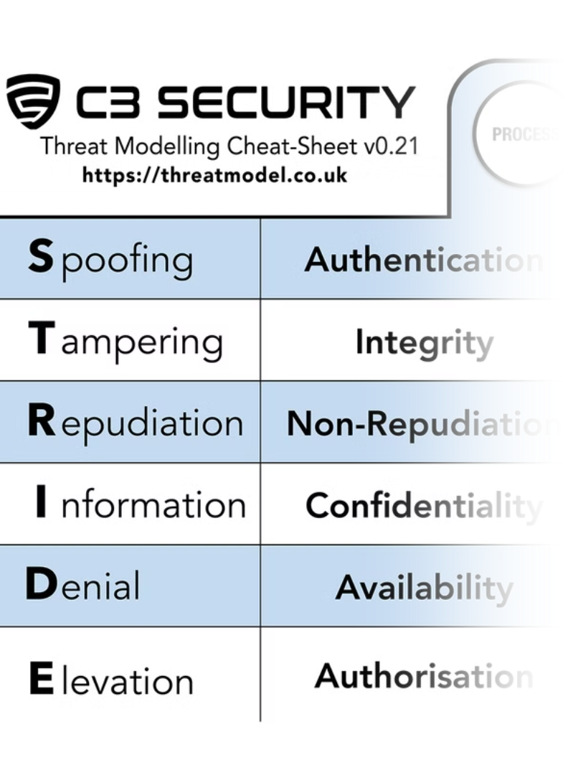
Deep Dive: STRIDE
STRIDE provides a comprehensive framework for identifying different types of security threats. This mnemonic helps teams systematically consider various attack vectors that might affect their systems, ensuring thorough coverage during threat analysis.
By applying STRIDE to each component of a system, teams can brainstorm possible threats and develop appropriate mitigations for each category, creating a more robust security posture.
Threat Type
Description
Spoofing
Impersonating identities
Tampering
Modifying data or processes
Repudiation
Denying actions performed
Information Disclosure
Data leakage
Denial of Service
Interrupting availability
Elevation of Privilege
Unauthorized access escalation

Slide 10




STRIDE per Element
Applying STRIDE to different system elements ensures comprehensive threat coverage. Each component type—processes, data stores, data flows, and external interactors—has unique vulnerability patterns that can be systematically identified using the STRIDE framework.
This element-specific approach helps teams focus their analysis on the most relevant threat types for each component, making the threat modeling process more efficient and effective.
Processes
Data Stores
Data Flows
External Interactors
Vulnerable to input validation flaws, buffer overflows, and injection attacks that could compromise execution.
May lack encryption, access controls, or integrity checks, leading to data breaches or corruption.
Can be intercepted, modified, or redirected if not properly secured with encryption and authentication.
Potential sources of spoofed requests, malicious inputs, or unauthorized access attempts.

Slide 11
Risk Prioritization (DREAD/CVSS/FAIR)
Once threats are identified, organizations need frameworks to prioritize them based on risk. Several methodologies provide structured approaches to risk assessment, helping teams focus their mitigation efforts on the most critical issues.
The choice of risk assessment framework should match your team's maturity and decision-making needs. Each approach offers different perspectives on risk, from qualitative ratings to quantitative analysis.
DREAD
CVSS
FAIR
Evaluates threats across five dimensions:
Common Vulnerability Scoring System:
Factor Analysis of Information Risk:
Damage potential
Industry-standard severity score (0–10)
Quantitative risk modeling
Reproducibility
Considers base, temporal, and environmental metrics
Analyzes loss event frequency and magnitude
Exploitability
Affected users
Provides consistent, comparable ratings
Supports financial risk calculations
Discoverability
Widely used for communicating vulnerability severity.
Best for organizations seeking to quantify security risk in financial terms.
Provides a simple scoring system accessible to non-security experts.

Slide 12






Common Mitigations
Effective threat mitigation relies on applying secure design principles and implementing appropriate technical controls. These defensive measures help address identified threats and reduce overall security risk.
When complete mitigation isn't feasible, organizations should document risk acceptance decisions, ensuring that security trade-offs are made consciously and with appropriate stakeholder involvement.
Technical Controls
Authentication, encryption, input validation, logging
Secure Design Principles
Least privilege, fail securely, secure defaults
Risk Documentation
Formal acceptance of residual risks
The most effective security strategies combine multiple layers of defense. Technical controls implement specific protections, while secure design principles guide architectural decisions. When certain risks cannot be fully mitigated, formal risk acceptance processes ensure that decisions are documented and reviewed appropriately.

Slide 13








Make It Continuous
Threat modeling isn't a one-time activity but an evolving artifact that should be updated throughout the system lifecycle. Regular updates ensure that security considerations remain aligned with the current state of the system.
Automation tools like Threagile and pytm can help integrate threat modeling into development workflows, making it easier to maintain models as systems evolve and reducing the manual effort required.
Per Sprint or Feature
After Major Refactors
Update models with each development increment
Reassess when architecture changes
Automate Where Possible
During Incidents
Use tools to streamline the process
Incorporate lessons from security events

Slide 14
Overview of NIST CSF v2
The NIST Cybersecurity Framework version 2 provides a flexible structure for managing cybersecurity risks. It expands on the original framework by adding a new "Govern" function to the existing five core functions.
This comprehensive approach helps organizations establish, assess, and improve their cybersecurity posture through a common language and systematic methodology that can be tailored to specific needs and risk profiles.
Identify
Understand assets, risks, and dependencies
Protect
Implement safeguards and controls
Detect
Identify cybersecurity events
Respond
Take action on detected events
Recover
Restore capabilities after incidents
Govern
Align cybersecurity with business needs

Slide 15
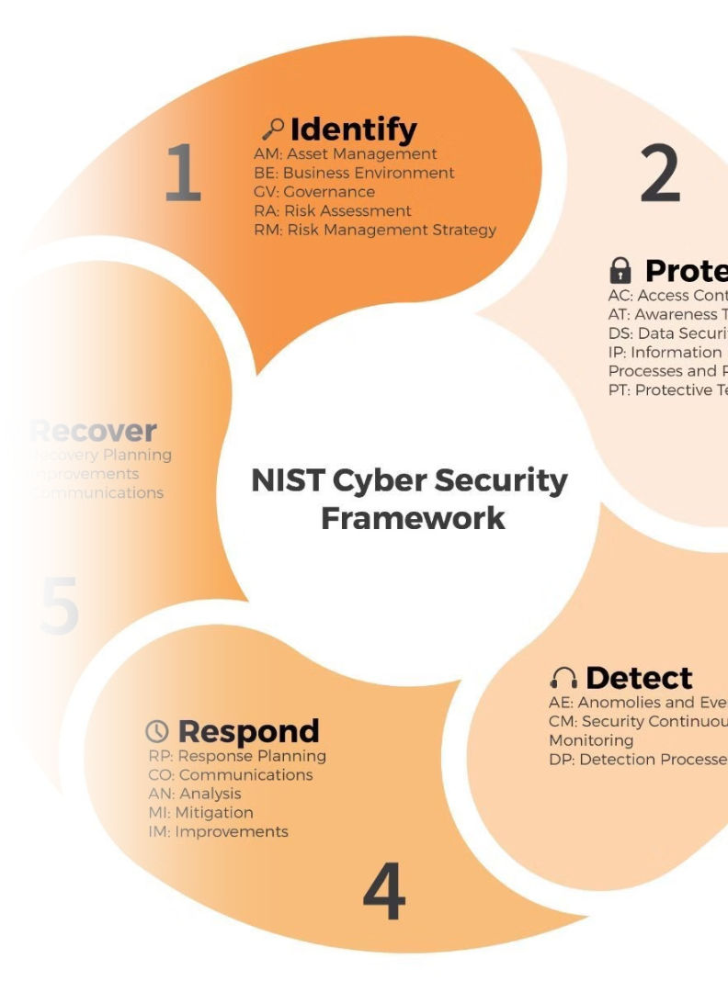
Where Threat Modeling Fits in NIST CSF v2
Threat modeling contributes to all six functions of the NIST CSF v2, providing valuable inputs that strengthen an organization's overall cybersecurity posture. By integrating threat modeling into the CSF implementation, organizations can enhance their security capabilities across the framework.
This alignment helps demonstrate the value of threat modeling beyond technical security, showing how it supports broader cybersecurity governance and risk management objectives.
CSF Function
Threat Modeling Contribution
Identify
Models assets, risks, dependencies
Protect
Defines controls and mitigations
Detect
Highlights logging and visibility gaps
Respond
Guides incident preparation
Recover
Informs recovery plans for key assets
Govern
Aligns with risk governance practices

Slide 16












STRIDE → NIST CSF Mapping (Example)
Mapping STRIDE threat categories to specific NIST CSF controls creates a practical connection between threat modeling outputs and framework implementation. This alignment helps organizations translate identified threats into concrete security measures.
By understanding these relationships, security teams can more effectively use threat modeling results to guide their CSF implementation and demonstrate how specific controls address identified threats.
Info Disclosure
Repudiation
PR.DS-2 (Data confidentiality)
Tampering
PR.PT-1 (Audit logs)
DoS
PR.DS-6 (Integrity protection)
DE.CM-1 (Anomalous behavior detection)
Privilege Escalation
Spoofing
PR.AC-1 (Access control)
PR.AC-3 (Least privilege)

Slide 17



Governance & Risk Alignment
Threat modeling provides valuable support for governance and risk management activities within the NIST CSF. By generating structured information about security risks and controls, threat modeling helps organizations make informed decisions about their cybersecurity investments.
The artifacts produced during threat modeling serve as documentation for audit purposes and provide traceability for security decisions, demonstrating due diligence in addressing potential threats.
Risk Management Strategy
Security Architecture Governance
Threat modeling supports GV.RM by providing structured risk information that feeds into the organization's overall risk management approach.
Aligns with GV.SC by ensuring security considerations are built into system designs and architectural decisions.
3rd-party and Supply Chain Analysis
Audit Artifacts
Contributes to ID.SC and GV.SU by identifying risks in external dependencies and integration points with third-party systems.
Provides documentation and decision traceability that demonstrates due diligence in addressing security risks.

Slide 18
Embedding Threat Modeling into CSF Execution
To maximize its value, threat modeling should be embedded into the organization's implementation of the NIST CSF. By treating threat modeling as an integral part of security processes rather than a standalone activity, organizations can achieve higher levels of CSF maturity.
This integration helps drive the organization toward Tier 3 (risk-informed) or Tier 4 (adaptive) CSF maturity, where security practices are proactive, risk-informed, and continuously improving.
Tier 4: Adaptive
Tier 3: Repeatable
Cybersecurity practices adapt based on lessons learned and predictive indicators; continuous improvement using advanced risk management techniques.
Tier 2: Risk Informed
Formal risk management practices are defined and implemented as organizational policy, with regular updates based on threat intelligence.
Tier 1: Partial
Risk management processes are approved but may not be established as organization-wide policy; prioritization of activities may be inconsistent.
Cybersecurity risk management is not formalized; activities are performed in an ad-hoc manner with limited awareness of risks.
Treating threat modeling as a security design control ensures that security is built into systems from the beginning. Using it as a risk communication tool helps bridge the gap between technical and business stakeholders. Aligning threat modeling with compliance requirements demonstrates how security activities contribute to regulatory obligations.

Slide 19
Best Practices & Pitfalls
✅ DO:
❌ DON'T:
Involve cross-functional stakeholders
Use as checkbox activity
Focus on what can go wrong, not just known bugs
Skip modeling because "it's Agile"
Iterate, document, and train continuously
Assume only security teams should do it

Slide 20
Q&A / Next Steps
As we conclude our discussion on threat modeling and NIST CSF v2, consider how you might begin implementing these practices in your organization. Starting small with a pilot project can help build momentum and demonstrate value before scaling to broader implementation.
Training your team and embedding threat modeling in your development processes are crucial steps toward creating a security-aware culture that proactively addresses potential threats.
Start Small
Train Your Team
Pilot threat model a feature or service to demonstrate value and learn from the experience.
Develop threat modeling skills across development, operations, and security teams.
Embed in Processes
Align with CSF
Integrate threat modeling into your SDLC or Agile rituals as a regular practice.
Map threat modeling outputs to CSF controls to demonstrate security value.

